Slide 1

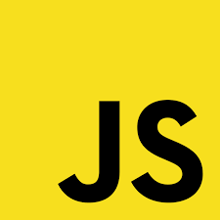
Javascript

Slide 2
Why JS was developed ?
Earlier there was only HTML and CSS were there to build applications, these applications were static.
Static applications are the ones in which you can not take in any user’s input and make some changes in styling or structure of application, so we needed to make the applications dynamic.
Dynamic applications are the ones in which you can take user’s data and save his information. And capturing data is the most important part of the application development.

Slide 3
History of JS
In 1990s, at the time of internet when Microsoft Internet Explorer and Netscape’s Navigator were getting released.
One of the Netscape’s developer named Brandan Eich developed JS in 10 days.
JS used to known as Mocha , then it used to get called as Livescript and then finally Javascript.
Javascript used to get confused with JAVA, but on the other hand they have nothing in common, Javascript is an interpreted language and Java is a compiler language.
Because of all this confusion and to maintain proper standardization in Javascript, Netscape introduced a body called ECMA (European Computer Manufacturers Association)

Slide 4
COMPILER | INTERPRETER
It takes an entire program at a time. | It takes a single line of a code at a time.
Compilation is done before execution | Compilation and Execution takes place simultaneously.
Faster because it translates the complete code at one go. | Slower because it translates each line and then execution happens which at last takes more time than compiler
It requires memory because it create object code | It does not require any memory.
Display all errors at the last. | Display errors after each line if exists.
C, C++ | Python, PHP

Slide 5
What is Javascript ?
Javascript is a scripting language that enables you to create dynamically updating content, control multimedia, animate images, and pretty much everything else.

Slide 6
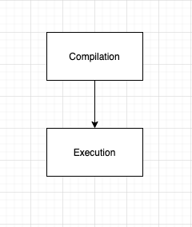
Stages of a Code Execution
Compilation : The stage in which the complete source code will be converted into machine language code.
Execution : In this stage the code will be executed means all the functions which are written will be executed.

Slide 7
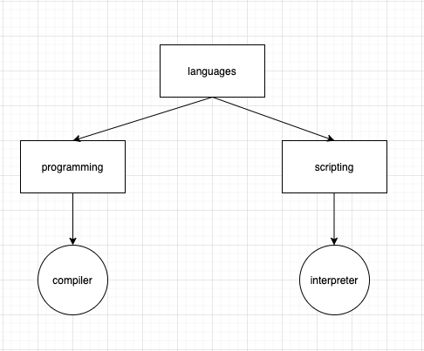
Compilation : Compilation process means the code will be converted into machine language (10101101..) code and make sure that the source code follows the correct syntax, if the syntax is not followed then the error will be thrown.

Slide 8
JS Engine
Now to run JS code we need JS engine, earlier it was believed that JS code can be run only in browser and only client side applications can be created.
So all the browsers are having their own JS engines to run JS code.
Later Ryan Dahl wrote some C++ and tried to run it using JS Engine, and it worked and we call it Node.JS.
So JS can be used for client-side application and server-side application as well, it just requires JS engine to run the code.

Slide 9

JS Engine
Google Chrome = V8 Engine
Mozilla Firefox = Spider Monkey Engine
Internet Explorer = Chakra

Slide 10




Client side
Server side

Slide 11
Add JS to HTML Page
We can use script tag in <body> tag of HTML file.
This script tag should be placed at the end of body tag means after complete HTML code.
<script src=“./index.js”></script>

Slide 12






JS Code Execution
Below are the few terminologies which comes under JS code execution :
Global Execution Context
Functional Execution Context
Call Stack
Memory Allocation
Code Execution

Slide 13
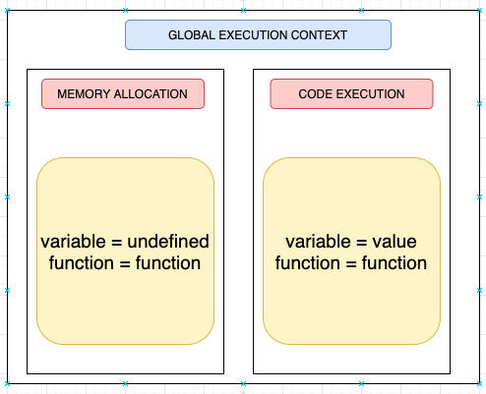
JS Code Execution

Slide 14
JS Code Execution
In the first stage “Memory allocation”, all the variables will get memory but will not be initialized means their value will not be given and it will be undefined, but functions will get their value or definition at the time of memory allocation only.
In the second stage “Code Execution”, variables will get assigned with their true values and functions will be executed.

Slide 15
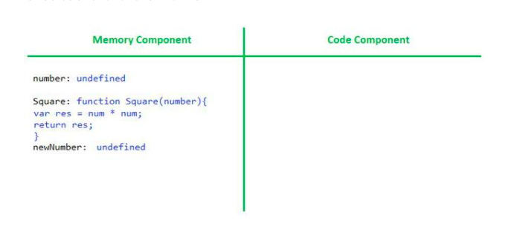
JS Code Execution
var number = 2;
function Square (n) {
var res = n * n;
return res;
}
var newNumber = Square(3);

Slide 16

Variables
80 marks in history
Percentage of marks
Grade she got
Print the marks
(80/100)
if(80>75)..Distinction
console.log(80)

Slide 17
Variables
var num = 1
var name = “PrepBytes”
var isCapital = true

Slide 18
Primitive Data types
Non - Primitive Data types
Strings
Numbers
Boolean
undefined
null
Objects

Slide 19
Variables
Variables can be created in JS using these:
var
let
const

Slide 20
var vs let vs const
var declarations are globally scoped or function scoped while let and const are block scoped.
var variables can be updated and re-declared within its scope
let variables can be updated but not re-declared
const variables can neither be updated nor re-declared.
Vars are hoisted
While var and let can be declared without being initialized, const must be initialized during declaration

Slide 21
Scoping of a Variable
Global Scope = Variables declared in global scope will be accessible at every point in the file, even inside a function.
Block Scope= Variables declared in a specific block like loops, if-else, or functions, these variables will not be accessible outside the blocks. It will be only accessible in the block where they have been declared.

Slide 22
Hoisting in JS
In JS each and every variable declared using either var, let or const gets some memory space.
If variable is declared using var then it will get memory space in global scope. So if you will try to access the variable in this case before initialising it then it will return “undefined”.
If variable is declared using either let or const then it will get memory space in separate scope not in global scope. So if you will try to access the variable in this case before initialising it then it will return Reference error saying you cannot access the variable before initialization.

Slide 23
Conclusion : Hoisting in JS
It is a concept which says that you should always declare and initialise all the variables is JS before using them.
If we will not initiate the variables (means giving or assigning the value to a variable) before using it , then it will throw errors. So to avoid such errors we should follow the concept of Hoisting in JS

Slide 24
Variables naming convention
Variable names can consist only of letters (a-z),(A-Z) numbers (0-9),
dollar sign symbols ($), and underscores (_)
Variable names cannot contain any whitespace characters (tabs or spaces)
A JavaScript identifier must start with a letter, underscore ( _ ), or dollar sign ( $ )
There are several reserved keywords which cannot be used as the
name of a variable
Variable names are case sensitive

Slide 25
Reserved keywords as of ECMAScript2015 - ES6

Slide 26
Keywords reserved only in strict mode
Keywords reserved only if it is not used in current module
Keywords reserved for future

Slide 27
Type Coercion
Type coercion is the automatic or implicit conversion
of values from one data type to another

Slide 28
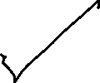

Operators
Arithmetic Operators
Comparison Operators
Bitwise Operators
Increment,Decrement Operators
Logical Operators
Ternary Operators
Comma Operator

Slide 29
Arithmetic Operators
%,- , +,/, *

Slide 30
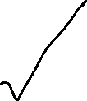
Comparison Operators
==, ===, !=, !==, >, <, >=, <=

Slide 31
Bitwise Operators
Bitwise And - a&b
Bitwise OR - a|b
Bitwise XOR - a^b
Bitwise NOT - ~a
Left Shift - a << b
Sign Propagating Right Shift - a >> b
Zero fill Right shift - a >>> b

Slide 32
Increment and Decrement Operators
Postfix increment - a++
Prefix increment - ++a
Postfix decrement - a--
Prefix decrement - --a

Slide 33
Logical Operators
&&, ||, !

Slide 34
Conditional or Ternary Operators
Condition ? Val1 : val2

Slide 35
Comma Operators
,

Slide 36
Decision Making
If it rains, I won’t go
If it doesn’t rain ,I will go

Slide 37
Decision Making
You can use if-else statement, if-elif-else statements when you are having very few conditions to check. If you have more that 4 conditions than switch statement will be more preferred.
let weather;
weather = "raining";
if (weather === "raining")
console.log(”I won't go for the party");
else
console.log(”I is will go to the party")

Slide 38
Switch Statement
switch(expression) {
case x:
// code block
break;
case y:
// code block
break;
default:
//code block
}

Slide 39
LOOPS
Below are the loops available in JS :
for loop
for-in loop
for-of loop
while
do-while loop

Slide 40
Loops
labeled statement
break statement
continue statement

Slide 41
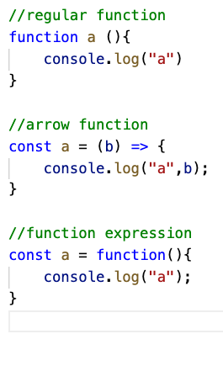
Functions
In JS, there are 3 ways to create a function:
Regular function
Arrow function
Function Expression

Slide 42
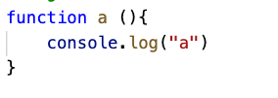

Function
Function definitions (function declaration, or function statement)
Function calling / invocation

Slide 43
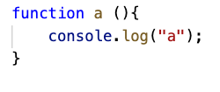


Function
Function without parameters
Function with parameters and no return
Function with parameters and with return

Slide 44
Strings
console.log(name[1]);
console.log(name.charAt(1));
console.log(“PrepBytes”.charAt(1));
console.log(“PrepBytes”[1]);

Slide 45
Strings comparison
let a = 'a'
let b = 'b'
if (a < b) { // true
console.log(a + ' is less than ' + b)
} else if (a > b) {
console.log(a + ' is greater than ' + b)
} else {
console.log(a + ' and ' + b + ' are equal.')
}

Slide 46
More string methods
var name = You will be an amazing developer
let index = name.indexOf(“developer”);
index = name.lastIndexOf(“developer”);
index = name.indexOf(“will”, 10);

Slide 47
Strings concatenation
Var string1 = Prep;
Var string2 = Bytes;
Var string3 = string1 + string2;
Console.log(string3);
Output : PrepBytes

Slide 48
Slicing
var name = You will be an amazing developer
var newMessage = name.slice(7,13);
newMessage = name.slice(-7, -13);
newMessage = name.slice(7);
newMessage = name.slice(-7);

Slide 49
Substring
Substring does not support negative index
For substr second parameter is length
Var name = You will be an amazing developer
Var newMessage = name.substr(7,13);
newMessage = name.substring(7);

Slide 50
Replace
var name = You will be an amazing developer
name.replace(‘ ’, ‘-’);
name.replaceAll(‘ ’, ‘-’)
name.trim();

Slide 51
split
var name = You will be an amazing developer
var nameList = name.split(“ ”);

Slide 52
Word.length
var newMessage = PrepBytes;
console.log(newMessage.length);
Output = 9

Slide 53
Strings comparison
let a = 'a'
let b = 'b'
if (a < b) { // true
console.log(a + ' is less than ' + b)
} else if (a > b) {
console.log(a + ' is greater than ' + b)
} else {
console.log(a + ' and ' + b + ' are equal.')
}

Slide 54
Regular Expression - RegExp in JS
Regular Expression are patterns used to match character combinations in string
^ : It matches the position just before the first character of the string.
$ : It matches the position just after the last character of the string.
. : matches a single character. Does not matter what character it is, except newline
* : matches preceding match zero or more times.

Slide 55
Arrays
An array is an ordered list of values that you refer to with a name and an index.
An array is an ordered list of values stored in continuous memory location.
11 | 34 | 45 | 56 | 78 | 89 | 90 | 54 | 67 | 78 | 54 | 32

Slide 56
Arrays
let arr = new Array(element0, element1,……,elementN)
let arr = Array(element0, element1…elementN)
let arr = [element1, element2, element3]
let arr = new Array(arrayLength)
let arr = Array(arrayLength)
let arr = []

Slide 57
Arrays Methods
let myArr = [1,2,3]
myArr.concat(5,6,7)
let myArr = [“Hi”,”How”,”Are”,“You”]
myArr.join(“-”)

Slide 58
Arrays Methods
let myArr = [1,2,3]
myArr.push(7)
myArr.pop()
myArr.shift()
myArr.unshift(‘4’,’5’)

Slide 59
Arrays Methods
let myArr = [1,2,3,4,5,6,3]
myArr.slice(1,3)
myArr.splice(1,3,’a’,’b’,’c’,’d’)
myArr.reverse()
myArr.sort()
myArr.indexOf(3)
myArr.lastIndexOf(3)

Slide 60
For each
let myArr = [“Hi”,”How”,”Are”,“You”]
myArr.forEach(function(item) {
console.log(item)
})
myArr.map((item)=> {
console.log(item)
})

Slide 61
Filter
let myArr = [“Hi”,”How”,”Are”,“You”]
let myNewArr = myArr.filter((item)=>
return typeof item == String)

Slide 62
Some and Every
let myArr = [“Hi”,”How”,”Are”,“You”]
let myNewArr = myArr.filter((item)=> return typeof item == String)

Slide 63
Maps
let sayings = new Map()
sayings.set(‘dog’, ‘woof')
Saying.set(‘cat’, ‘meow’)
sayings.size
sayings.get(‘dog’)
sayings.get(‘fox’)
sayings.has(‘fox’)
sayings.delete(‘fox’)
saying.size
for(let[key,value] of sayings) {
console.log(key + ' goes ' + value);
}

Slide 64
Maps
let sayings = new Map()
sayings.set(‘dog’, ‘woof')
Saying.set(‘cat’, ‘meow’)
sayings.size
sayings[‘dog’]
map.forEach()

Slide 65
Sets
let mySet = new Set();
myset.add(1)
for(let[key,value] of sayings) {
console.log(key + ' goes ' + value);
}

Slide 66
Javascript Objects

Slide 67
What are Objects?
An object is a collection of related data and/or functionality (which usually
consists of several variables and functions — which are called properties
and methods when they are inside objects.)

Slide 68
Objects
var user= {
name: ”Rahul”,
profession: “Teacher”,
hobbies: [“Reading”, “Dancing”]
}
How to access object keys or attributes
user.name gives “Rahul”
user.profession gives “Teacher”

Slide 69
Objects
var Rahul= {
name: ”Rahul”,
profession: “Teacher”,
hobbies: [“Reading”, “Dancing”],
bio: function() {
console.log(`Hi! I am ${name}, my profession is
${profession})
}
}

Slide 70
What are Object Literals?
An object initializer is a comma-delimited list of zero or more pairs of property
const a = 'rahul';
const b = 24;
const c = {};
const object = { name: a, age: b, personalInfo: c };

Slide 71
Objects using Constructor
In Javascript, we can create objects using function constructor and class constructor.
Both class and function constructors returns an empty object.
“this” keyword will be associated with the new object.
There will be one prototype object will also be added to this new object. This prototype object contains the information that if newly created object is created by class constructor or function constructor.

Slide 72
Create objects using Function Constructor
function Car(make, model, year) {
this.make = make;
this.model = model;
this.year = year;
}
const car1 = new Car('Eagle', 'Talon TSi', 1993);

Slide 73
Create objects using Class Constructor
class Rectangle {
constructor(height, width) {
this.height = height;
this.width = width;
}
}
const square = new Rectangle(10,10);

Slide 74
Object.keys
const user = {
a: 'student',
b: 42,
};
console.log(Object.keys(user));
// expected output: Array ["a", "b"]

Slide 75
Object.values
const user = {
a: 'student',
b: 24,
};
console.log(Object.values(user));
// expected output: Array ["student", 24]

Slide 76
Spread Operator in JS
This operator allows an iterable such as an array expression or string where zero or more arguments for function calls are expected or an object expression
const str = "abc"
console.log(…str);
Output : “a” “b” “c”

Slide 77
First class functions in JS
Functions which gets treated as a variable. It can be passed as an argument to other functions, can be returned by another function and can be assigned as a value to a variable.
const foo = function() {
console.log(“Hello World”);
}
foo();
O/P : Hello World

Slide 78
Higher order functions in JS
Functions which receives another function as an argument or returns another function.
const foo = function() {
return function(){
console.log(“Hello World”);
}
}
foo()();
O/P : Hello World

Slide 79
Prototypes in JS
Prototypes are the mechanism by which Javascript objects inherit features from one another.
__proto__ object will be created inside the object which will refer to the Prototype of its class constructor or function constructor whenever an object will be created.
Using prototype property we can also add more elements to an object which will be accessible by other objects also(the objects which will be created by same function or class constructor).

Slide 80
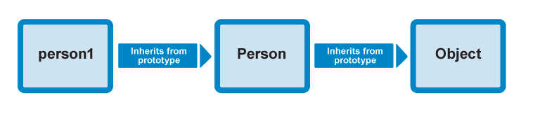
Prototypes in JS & Prototype Chaining

Slide 81
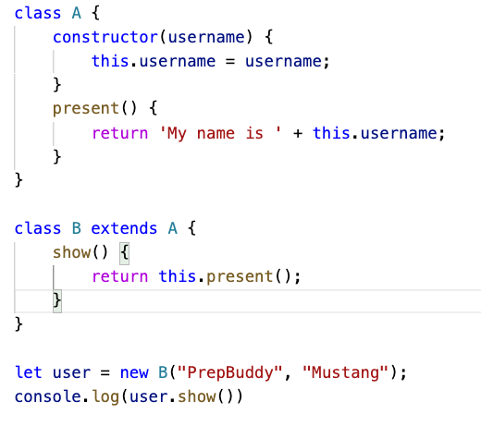
Inheritance in JS
A class created with a class inheritance inherits all the properties from other class.
Output :
My name is PrepBuddy

Slide 82
Closures
A closure gives access to variables or other properties of outer function or parent to inner function or child function by creating a lexical environment.
function test() {
var name = 'Prepbytes'; // name is a local variable defined inside test
function showName() { // showName() is the inner function, a closure
console.log(name); // use variable declared in the parent function
}
showName();
}
test();

Slide 83
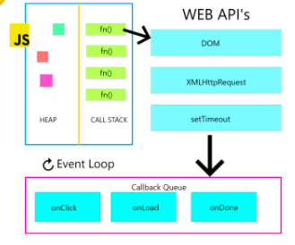
Event Loop
The event loop has one simple job : to monitor the call stack and callback queue. If the call stack is empty, the event loop will take the first item from the callback queue and will push it to call stack, which will effectively runs it

Slide 84
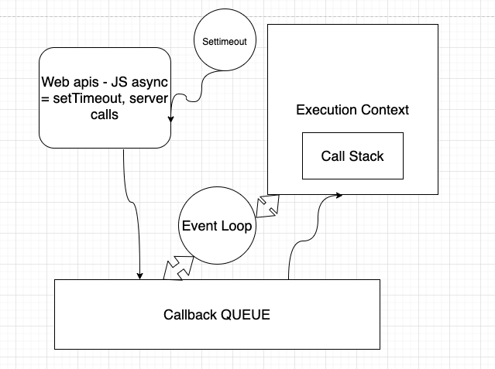
Event Loop

Slide 85
What is DOM?

Slide 86
The Document Object Model (DOM) is the data representation of the objects that comprise the structure and content of a document on the web.
It represents the page so that programs can change the document structure, style, and content. The DOM represents the document
as objects. That way, languages like Javascript can connect to the page.

Slide 87

<!DOCTYPE html>
<html lang="en">
<head>
<title>Document</title>
</head>
<body>
<h1>Javsacript</h1>
<button>Click Me</button>
<ul>
<li>Item 1</li>
<li>Item 2</li>
<li>Item 3</li>
</ul>
</body>
</html>
DOM?

Slide 88
<!DOCTYPE html>
<html lang="en">
<head>
<title>Document</title>
</head>
<body>
<h1>JavaScript</h1>
<button>Click Me</button>
<ul>
<li>Item 1</li>
<li>Item 2</li>
<li>Item 3</li>
</ul>
</body>
</html>
head
meta
html
h1
body
button
li
ul
li
li

Slide 89
DOM functions
Finding the existing HTML elements from DOM
Find an element by its id attribute : document.getElementById(id)
Find an element by its tag name :(div, span) document.getElementsByTagName(name)
Find an element by its class attribute : document.getElementsByClassName(name)

Slide 90
DOM functions
Changing the html elements value :
element.innerHTML : Changes inner html of an element
element.style.property : changes the style of an html element
element.getAttribute(“id”) : gives the attribute value of element
element.setAttribute(“id”,”test”) : set a new attribute or existing with the given value

Slide 91
DOM functions - Adding Dynamic HTML
Adding dynamic html elements in DOM:
document.createElement(element) : create an HTML element
document.appendChild(element) : add an HTML element

Slide 92
jQuery
It is a javascript library which simplifies DOM manipulation , event handling and animation in HTML. It’s most important feature is Ajax.
Selectors :
By class name of element = .classname
By id of the element = #id
By tag name of element = tag
By this keyword = this

Slide 93
jQuery Event handlers
Mouse Events | Keyboard Events | Form Events | Document/Window Events
click | keypress | submit | load
dblclick | keydown | change | resize
mouseenter | keyup | focus | scroll
mouseleave |  | blur | unload

Slide 94
jQuery - Ajax
Ajax allows you to update the DOM or the webpage without reloading the page. Means you can get the data from the server and display it on the page without reloading it.

Slide 95
Call, Apply and Bind in JS - Call
Call invokes the function and allows you to pass in arguments one by one.
var person1 = {firstName: 'Prepbytes', lastName: 'Students'};
function test(greeting, year) {
console.log(greeting + ' ' + this.firstName + ' ' + this.lastName + ' ' + year);
}
test.call(person1, 'Hello'); // Hello Prepbytes Students 2021

Slide 96
Call, Apply and Bind in JS- Apply
Apply invokes the function and allows you to pass in arguments as an array.
var person1 = {firstName: 'Prepbytes', lastName: 'Students'};
function test(greeting, year) {
console.log(greeting + ' ' + this.firstName + ' ' + this.lastName + ' ' + year);
}
test.apply(person1, [‘Hello’, 2021]); // Hello Prepbytes Students 2021

Slide 97
Call, Apply and Bind in JS - Bind
Bind returns a new function, allowing you to pass in a this array and any number of arguments.
var person1 = {firstName: 'Prepbytes', lastName: 'Students'};
function test(greeting, year) {
console.log(greeting + ' ' + this.firstName + ' ' + this.lastName + ' ' + year);
}
var user = test.bind(person1);
user(“Hello”,2021) // Hello Prepbytes Students 2021

Slide 98
Callbacks in JS
Callback function is a function which gets passed as an argument to another function , so that we can achieve this that callback function should be called only after the execution of main function.

Slide 99
Promises in JS
The Promise object represents the eventual completion or failure of an asynchronous operation and its resulting value.
It takes in two parameters resolve and reject , if we are getting success response then we will use resolve to give response, if error comes then we will use reject to give error.
It provides two functions .then and .catch. If you want to access response use .then, if you want to handle error use .catch function.

Slide 100
Promises, async, await in JS
async function try() {
let myPromise = new Promise(function(resolve, reject) {
resolve(“Hello World");
});
const result = await myPromise;
return result;
}
try();

Slide 101
Async and Await in JS
An async keyword will be added to a function when you want that function to perform in a asynchronous way in JS.
For this asynchronous behaviour we have to write await keyword in the line where we want the code to hold.
Note : If async keyword is not added in the function then we cannot write await in that function.

Slide 102
Debouncing and Throttling in JS
These two techniques are used to limit the number of times a function can execute.
Normally its developer who decide how and when the functions should be called, but with event listeners this job becomes difficult. Example: If we have an event listener that on maximising and minimising the screen we are calling a function then this function will get called a lot of times if the user will keep on increase and decrease the screen size.

Slide 103
Debouncing and Throttling in JS
Throttling : It is technique in which no matter how many times the user fires the event, the attached function will be executed only once in a given time interval.
Debouncing : In this technique no matter how many times user fires the event, the attached function will be executed only after the specified time once the user stops firing the event.

Slide 104
Event Listeners
An event listener is a function applied on any HTML element.
Event listener takes minimum two parameters.
First parameter is event name like click, mouseout, mousemove, resize
Second parameter will be the function which needs to be executed after the event has happened.
addEventListener, removeEventListener

Slide 105
Event Listeners
Example : addEventListener
document.getElementById(“submitBtn")
.addEventListener(“click”,function(){alert(“Hello World !!”)});
Example : removeEventListener
document.getElementById(“submitBtn")
.removeEventListener(“click”,function(){alert(“Hello World !!”)});

Slide 106
ES6 v/s ES5
New variable declaration ways got added like let and const in ES6 , earlier in ES5 we had only var.
In ES6, we have got arrow functions which was not present in ES5.
Spread operator which gets used while working with objects also got added in ES6.
New primitive datatype got added known as “symbol” Ex: var user = Symbol();

Slide 107
Storage in JS : Local, Session and Cookies
Cookies :
Cookies stores very small amount of data.
This data can be sent back to the server with the server calls
This data’s expiration can be set from either client or server side
They are mostly used by server side.
They are accessible from any window and tab
Example : JWT Tokens

Slide 108
Storage in JS : Local, Session and Cookies
Local Storage :
It stores very large amount of data.
It has no expiration data and store data in key-value pair.
This data can never be accessed by server.
It can be accessible from any window.
Example : User credentials

Slide 109
Storage in JS : Local, Session and Cookies
Session Storage :
It stores very large amount of data.
It has no expiration data and store data in key-value pair.
This data can never be accessed by server.
It cannot be accessible by every window, although can be accessible in the same tab.
Example : Banking

Slide 110
Type Error, Syntax Error, Reference Error
Reference Error : It occurs when you try to use a variable that does not exist in the code at all.
Example : var a = 10;
console.log(b);
Output : ReferenceError : b is not defined.

Slide 111
Type Error, Syntax Error, Reference Error
Type Error : It occurs when you try to use a variable that does exist in the code, but the operation you are trying to perform is not valid.
Example : var a = 10;
console.log(a());
const b = 20;
B = 30
Output : TypeError : a is not a function. B Assignment to constant variable.

Slide 112
Type Error, Syntax Error, Reference Error
Syntax Error : These errors are detected while compiling or parsing the source code. These errors are human made errors
Example : If you have not closed any curly braces{ } while defining the function.

